Slide 1
Introduction to PHP Programming
Notes:
Type here……

Slide 2
Learning Objectives
-Describe what PHP is and how it works in web development
-Write basic PHP scripts using variables and output
-Use conditional statements and loops to control program flow
-Create simple PHP functions to organize reusable code

Slide 3
What is PHP?
PHP PHP: Hypertext Preprocessor
A popular server-side scripting language
Used to create dynamic websites and web applications
Embedded inside HTML and runs on a web server (like XAMPP)

Slide 4
Why Learn PHP?
Powers popular platforms (WordPress, Facebook originally used PHP)
Simple and beginner-friendly
Works well with HTML and MySQL
Prepares you for building real-world systems

Slide 5
Setting Up Your PHP Environment
Download and install XAMPP
Save .php files inside htdocs/ folder
Start Apache to run your server
Notes:
<?php
echo "Hello, world!";
?>

Slide 6
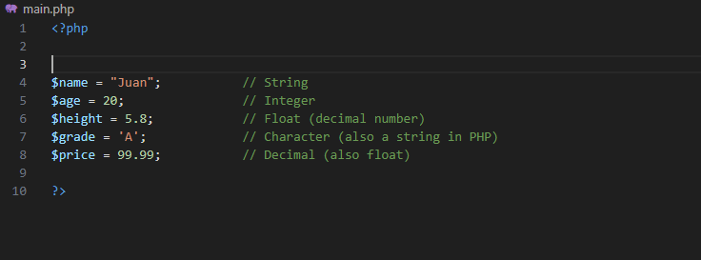
VARIABLES

Slide 7
VARIABLES

Slide 8
Input and Output in PHP
Output is how PHP displays data to the screen.
We use:
echo → for simple output
Examples:
echo "Hello, World!";

Slide 9
Input and Output in PHP
Form Input (Web Browser)
-Uses $_POST or $_GET from an HTML form.
Command Line Input (Terminal)
-Uses fgets(STDIN) or readline()
-Used when running PHP from the terminal.
Notes:
php –m –check if readline is enable

Slide 10
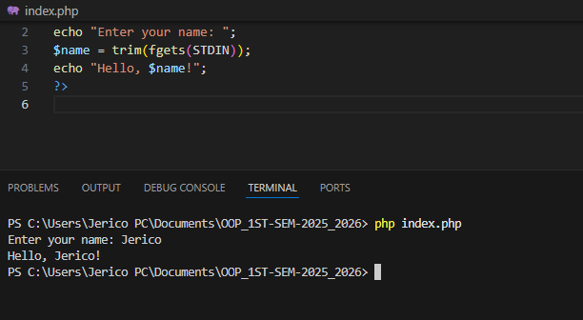
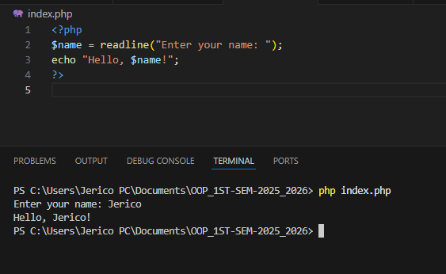
Input and Output in PHP
fgets(STDIN)
readline()
Notes:
STDIN stands for Standard Input.

Slide 11
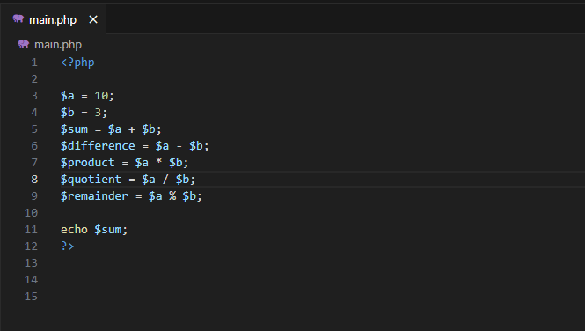
Operators
Arithmetic Operators

Slide 12
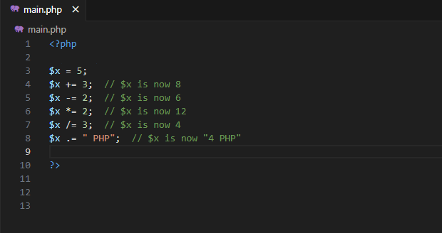
Operators
Assignment Operators

Slide 13
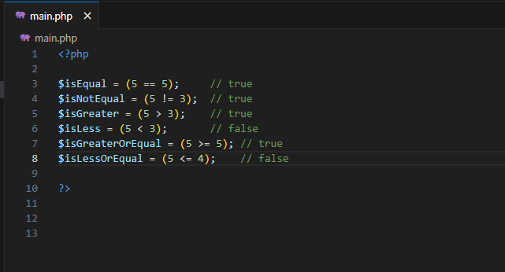
Operators
Comparison Operators

Slide 14
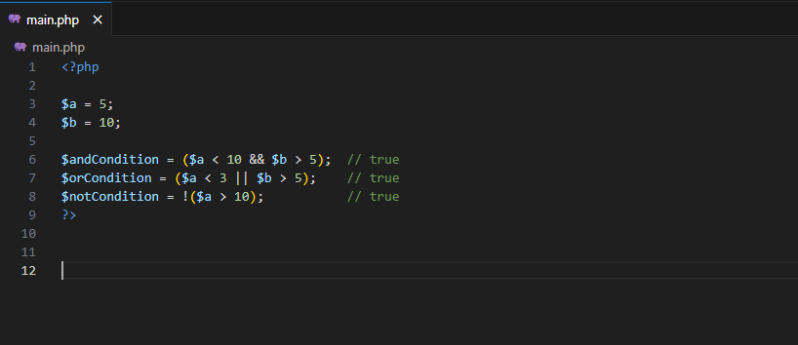
Operators
Logical Operators

Slide 15
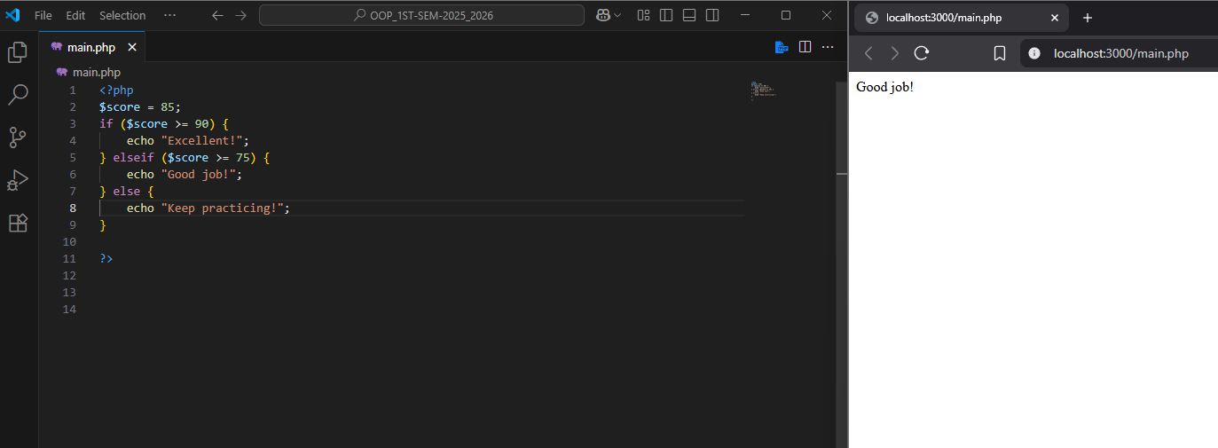
Conditional Statements

Slide 16
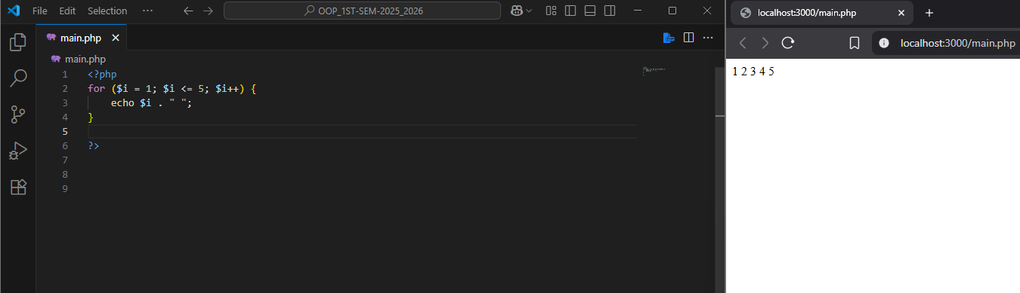
Loops – For Loop

Slide 17
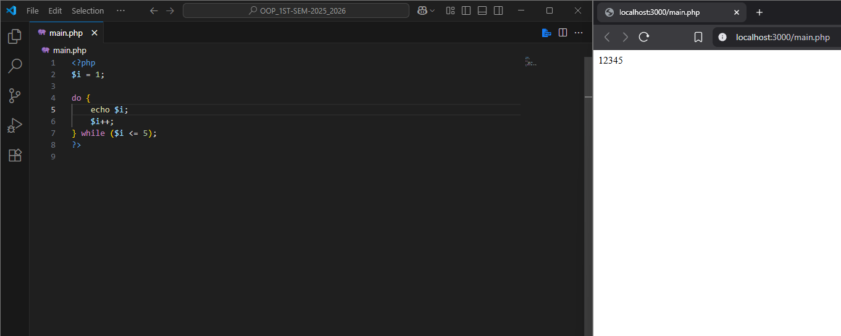
Loops – Do while

Slide 18
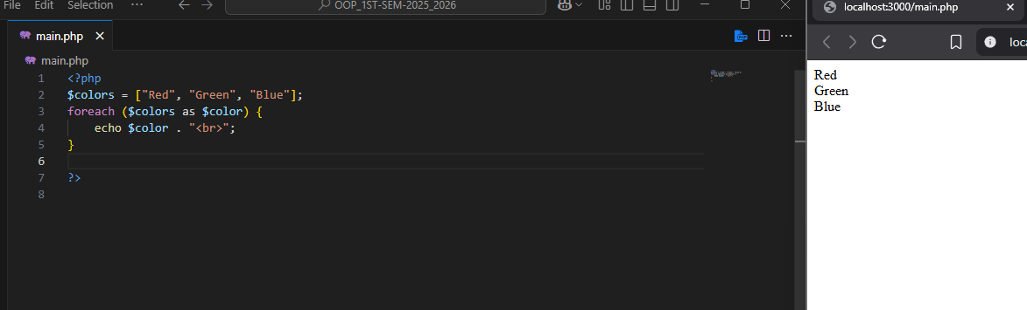
Loops – For Each

Slide 19
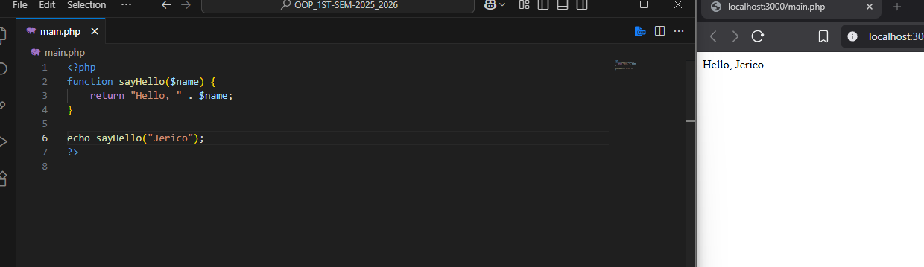
Functions in PHP

Slide 20
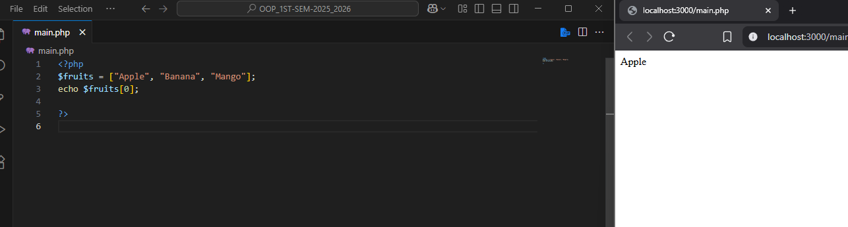
Arrays – Indexed Array

Slide 21
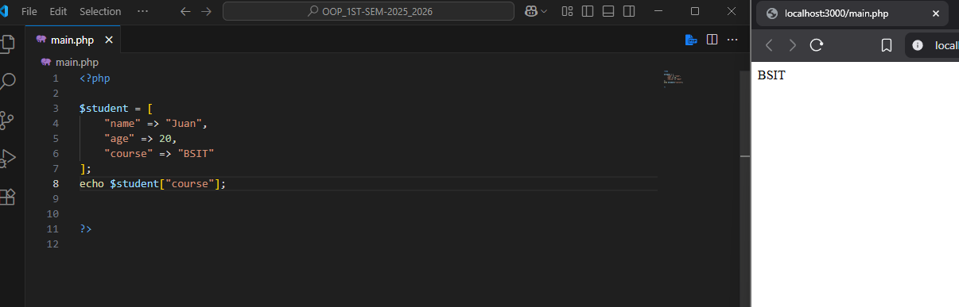
Arrays – Associative Array

Slide 22
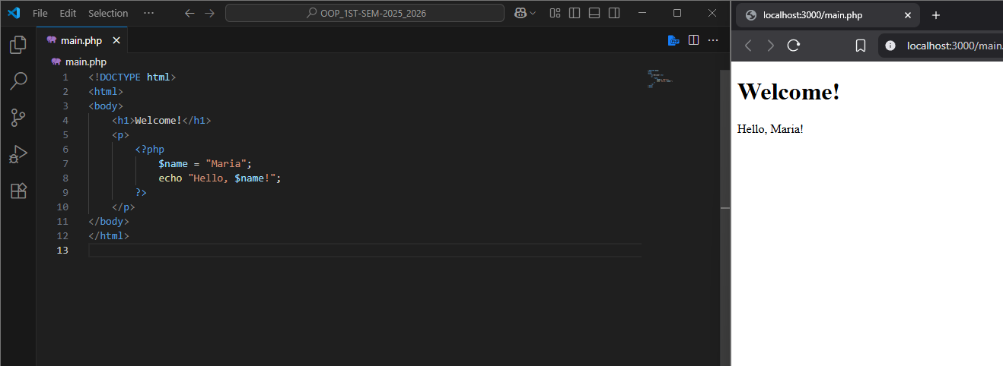
PHP Inside HTML

Slide 23
Practice Activity
Print Even Numbers:
Use a for loop to print all even numbers from 1 to 20.
Sum of Positive Numbers:
Write a program using a while loop that asks the user to enter 5 numbers and calculates the sum of all positive numbers only.

Slide 24
Thank you

